Slide 1

Beginner Svelte Training

Slide 2
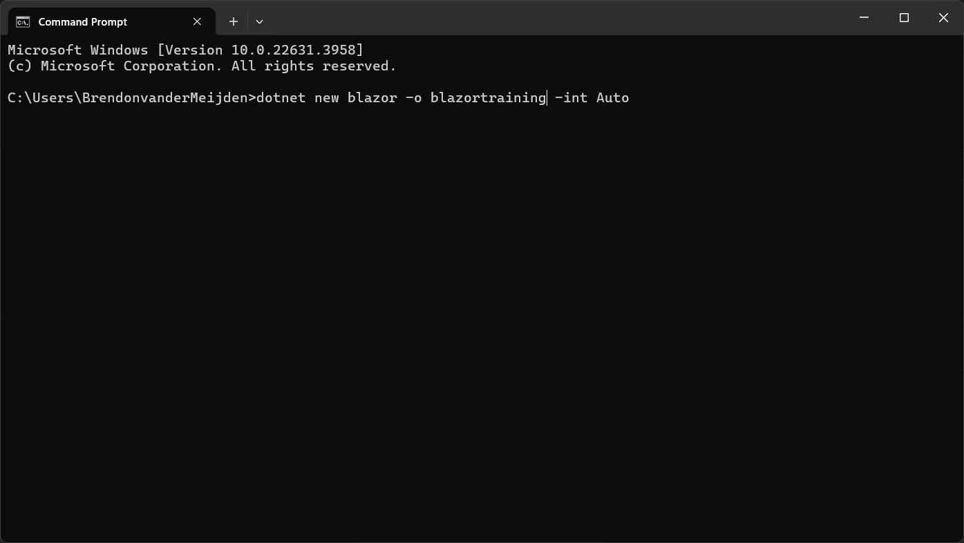
0a – Installing Blazor

Slide 3
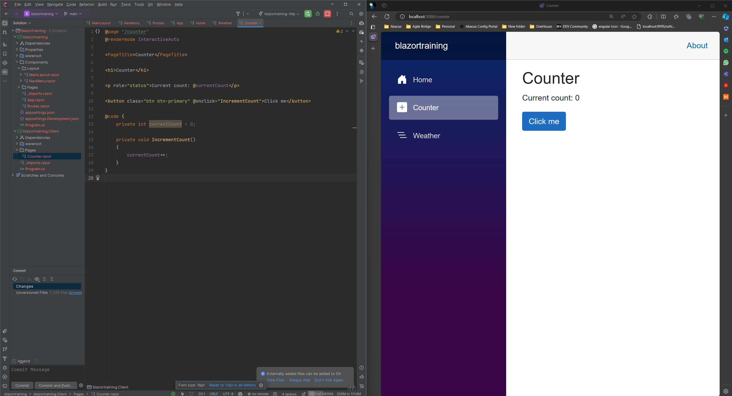
0d – The site up and running

Slide 4
Templating

Slide 5
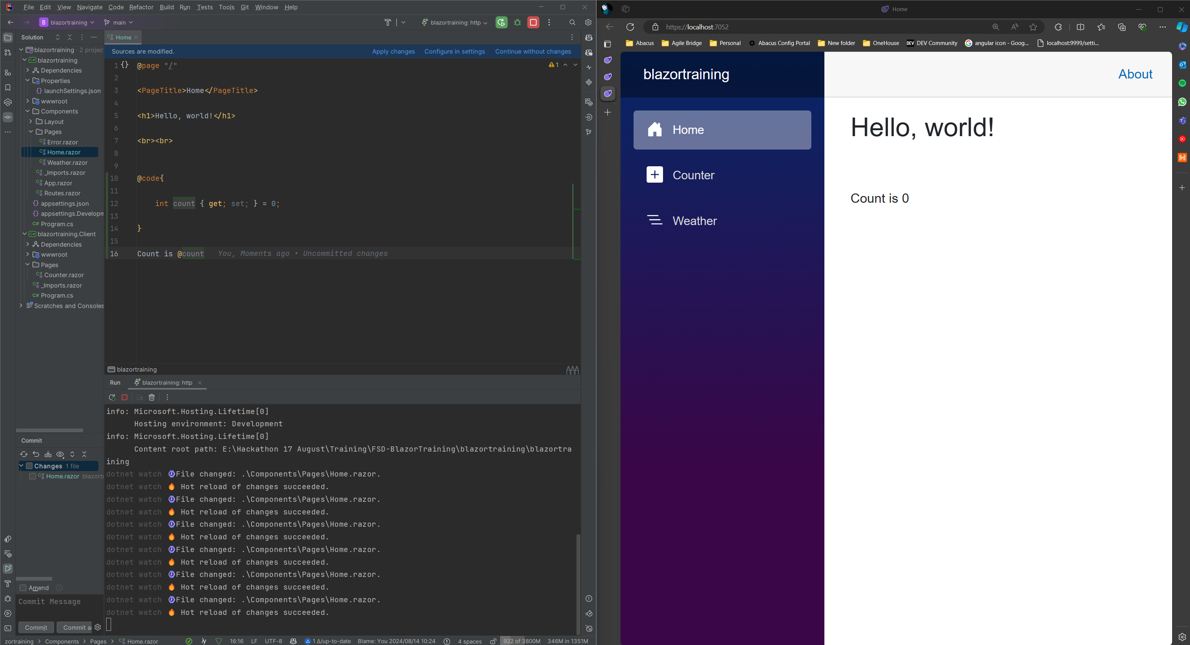
1a. One Way Bound Data

Slide 6
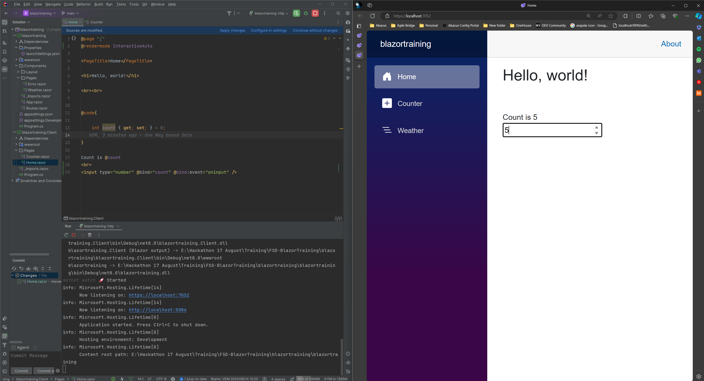
1b. Two Way Bound Data

Slide 7
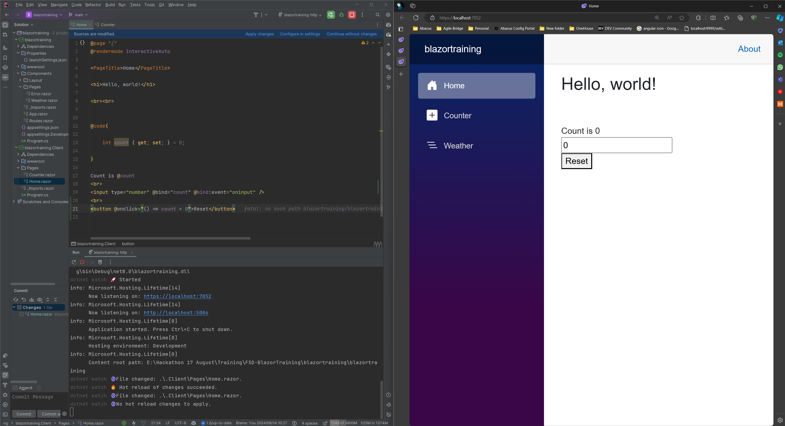
1c. Event handling

Slide 8
Componentization

Slide 9
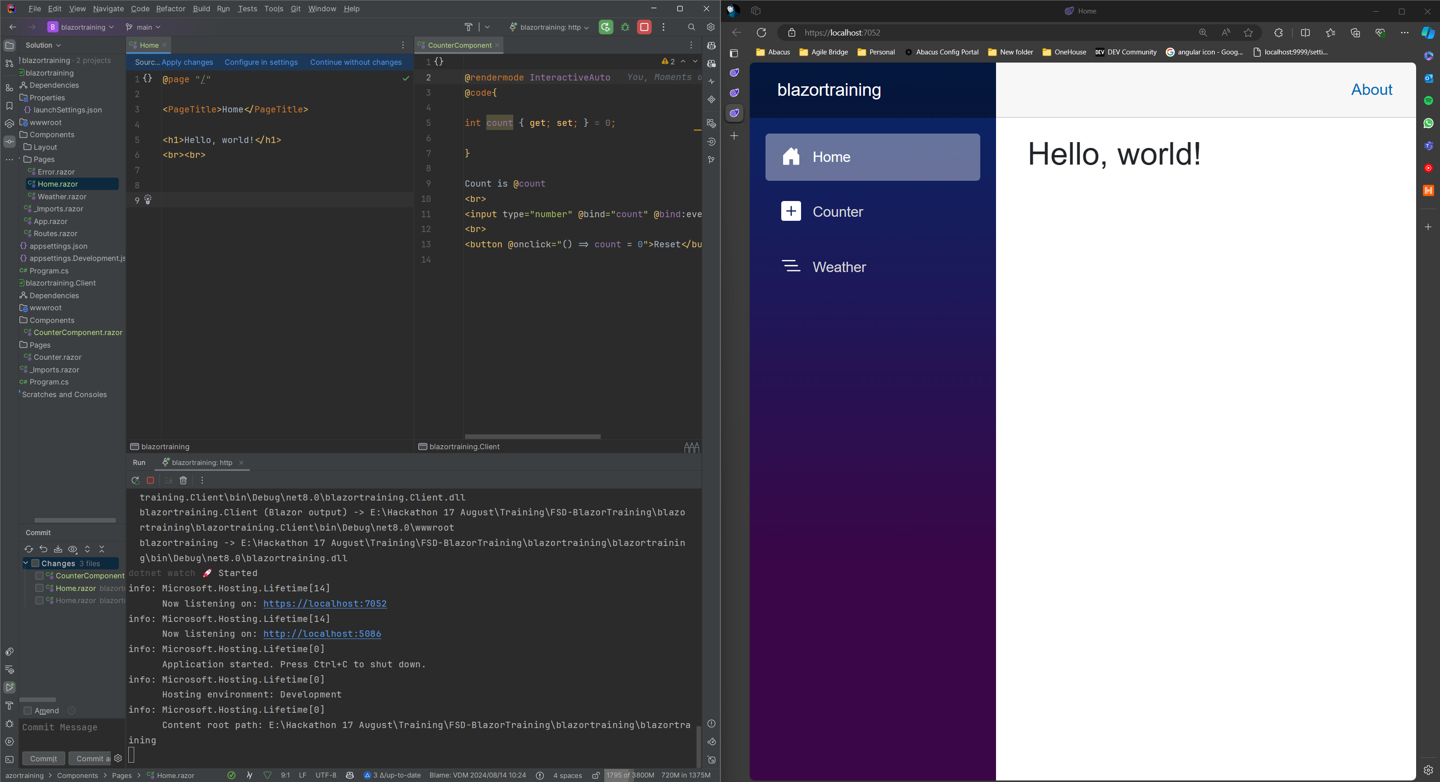
2a. Creating a component

Slide 10
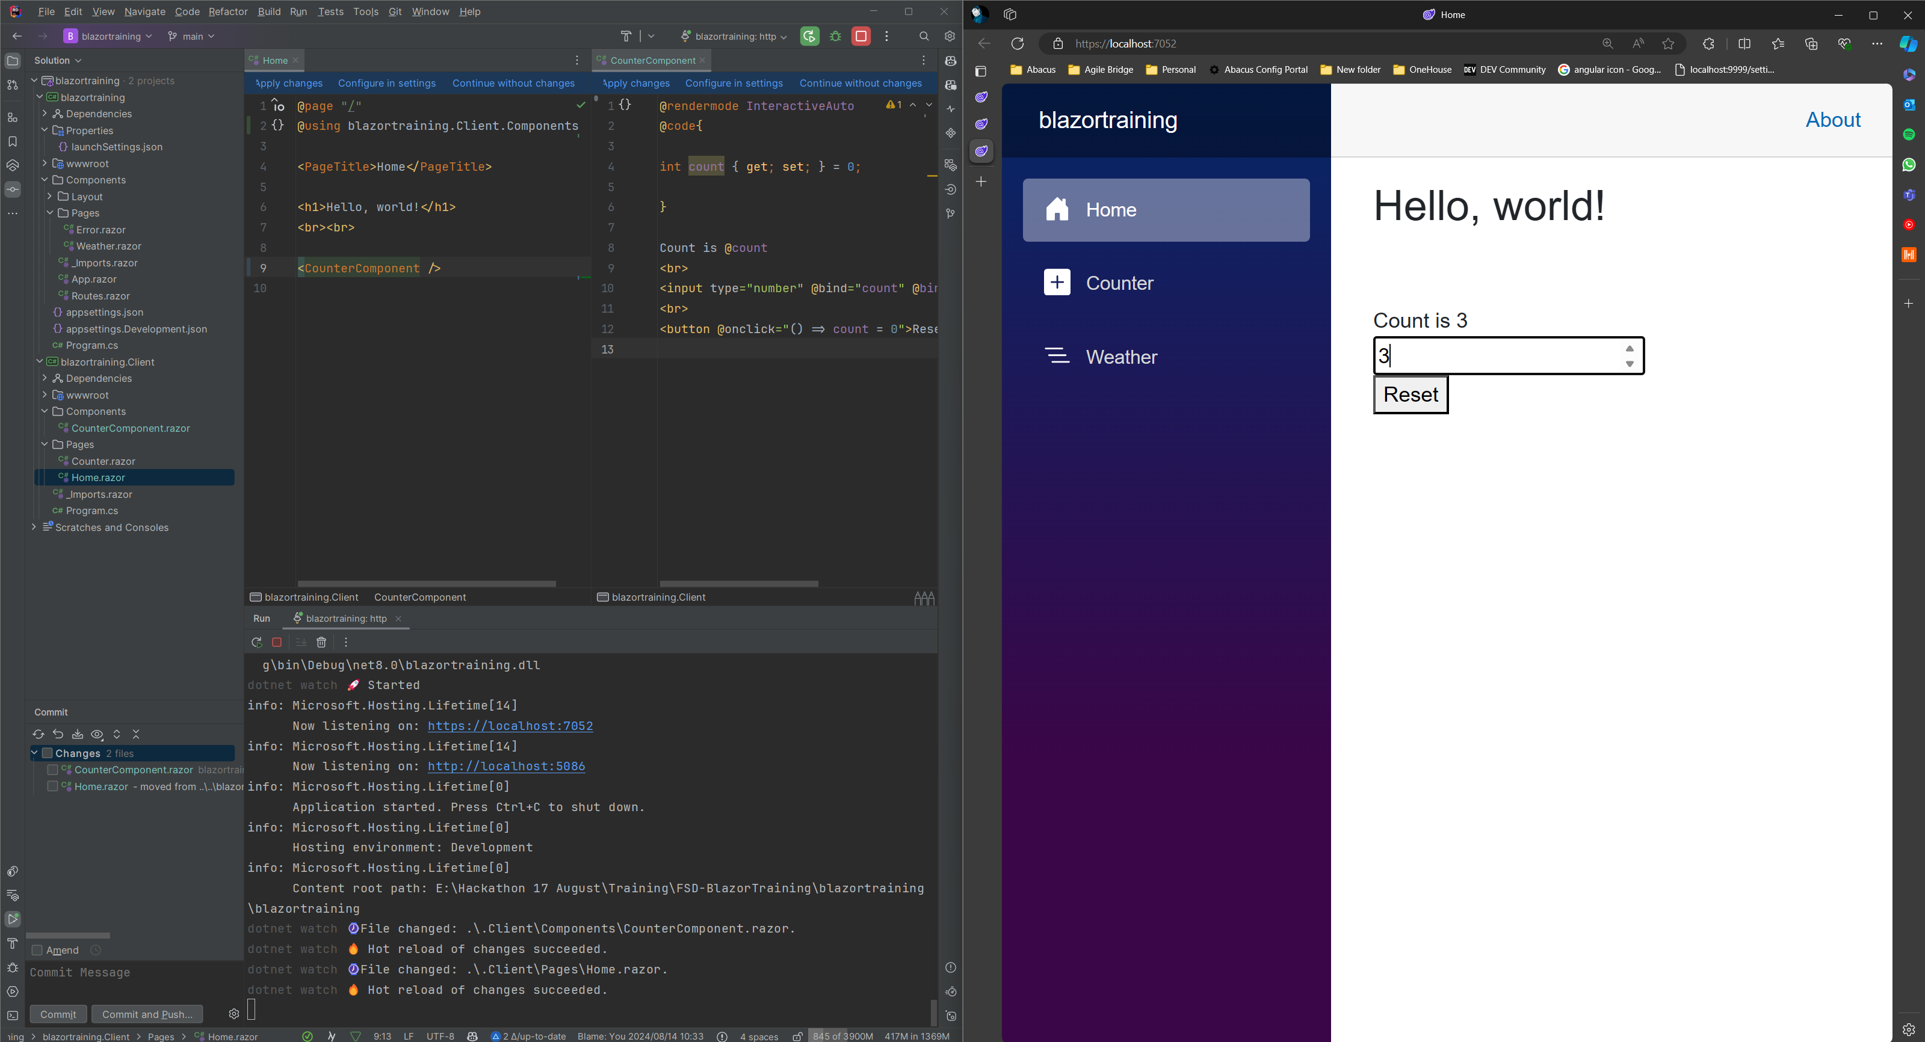
2b. Using the component

Slide 11
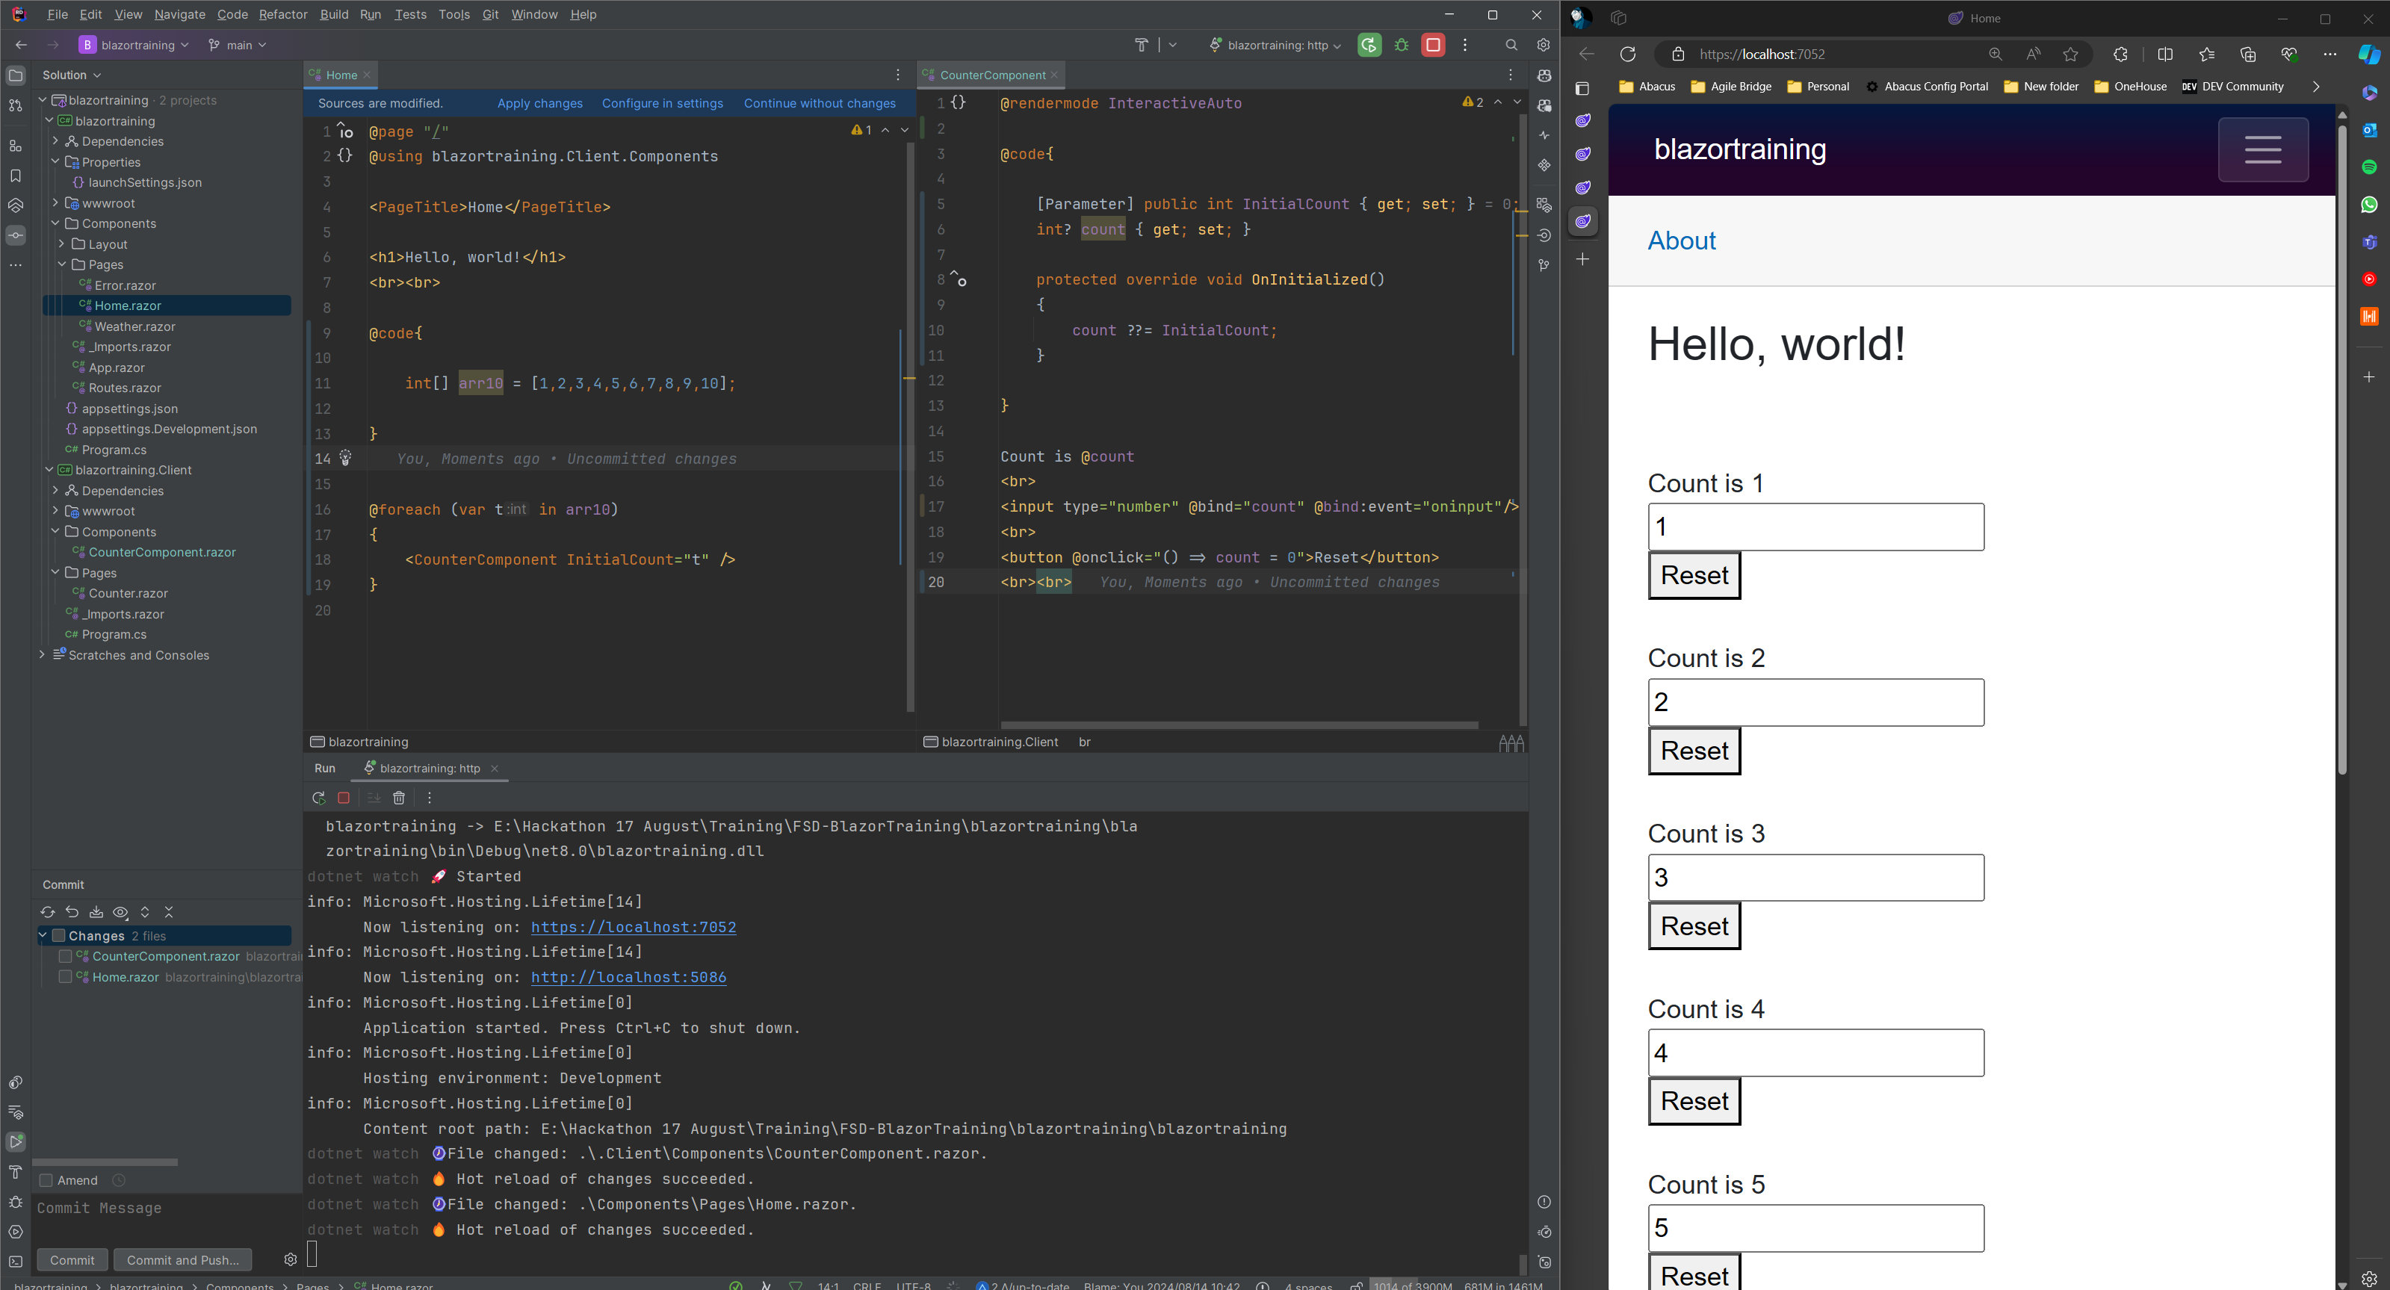
2c. Passing Data (props) to components

Slide 12
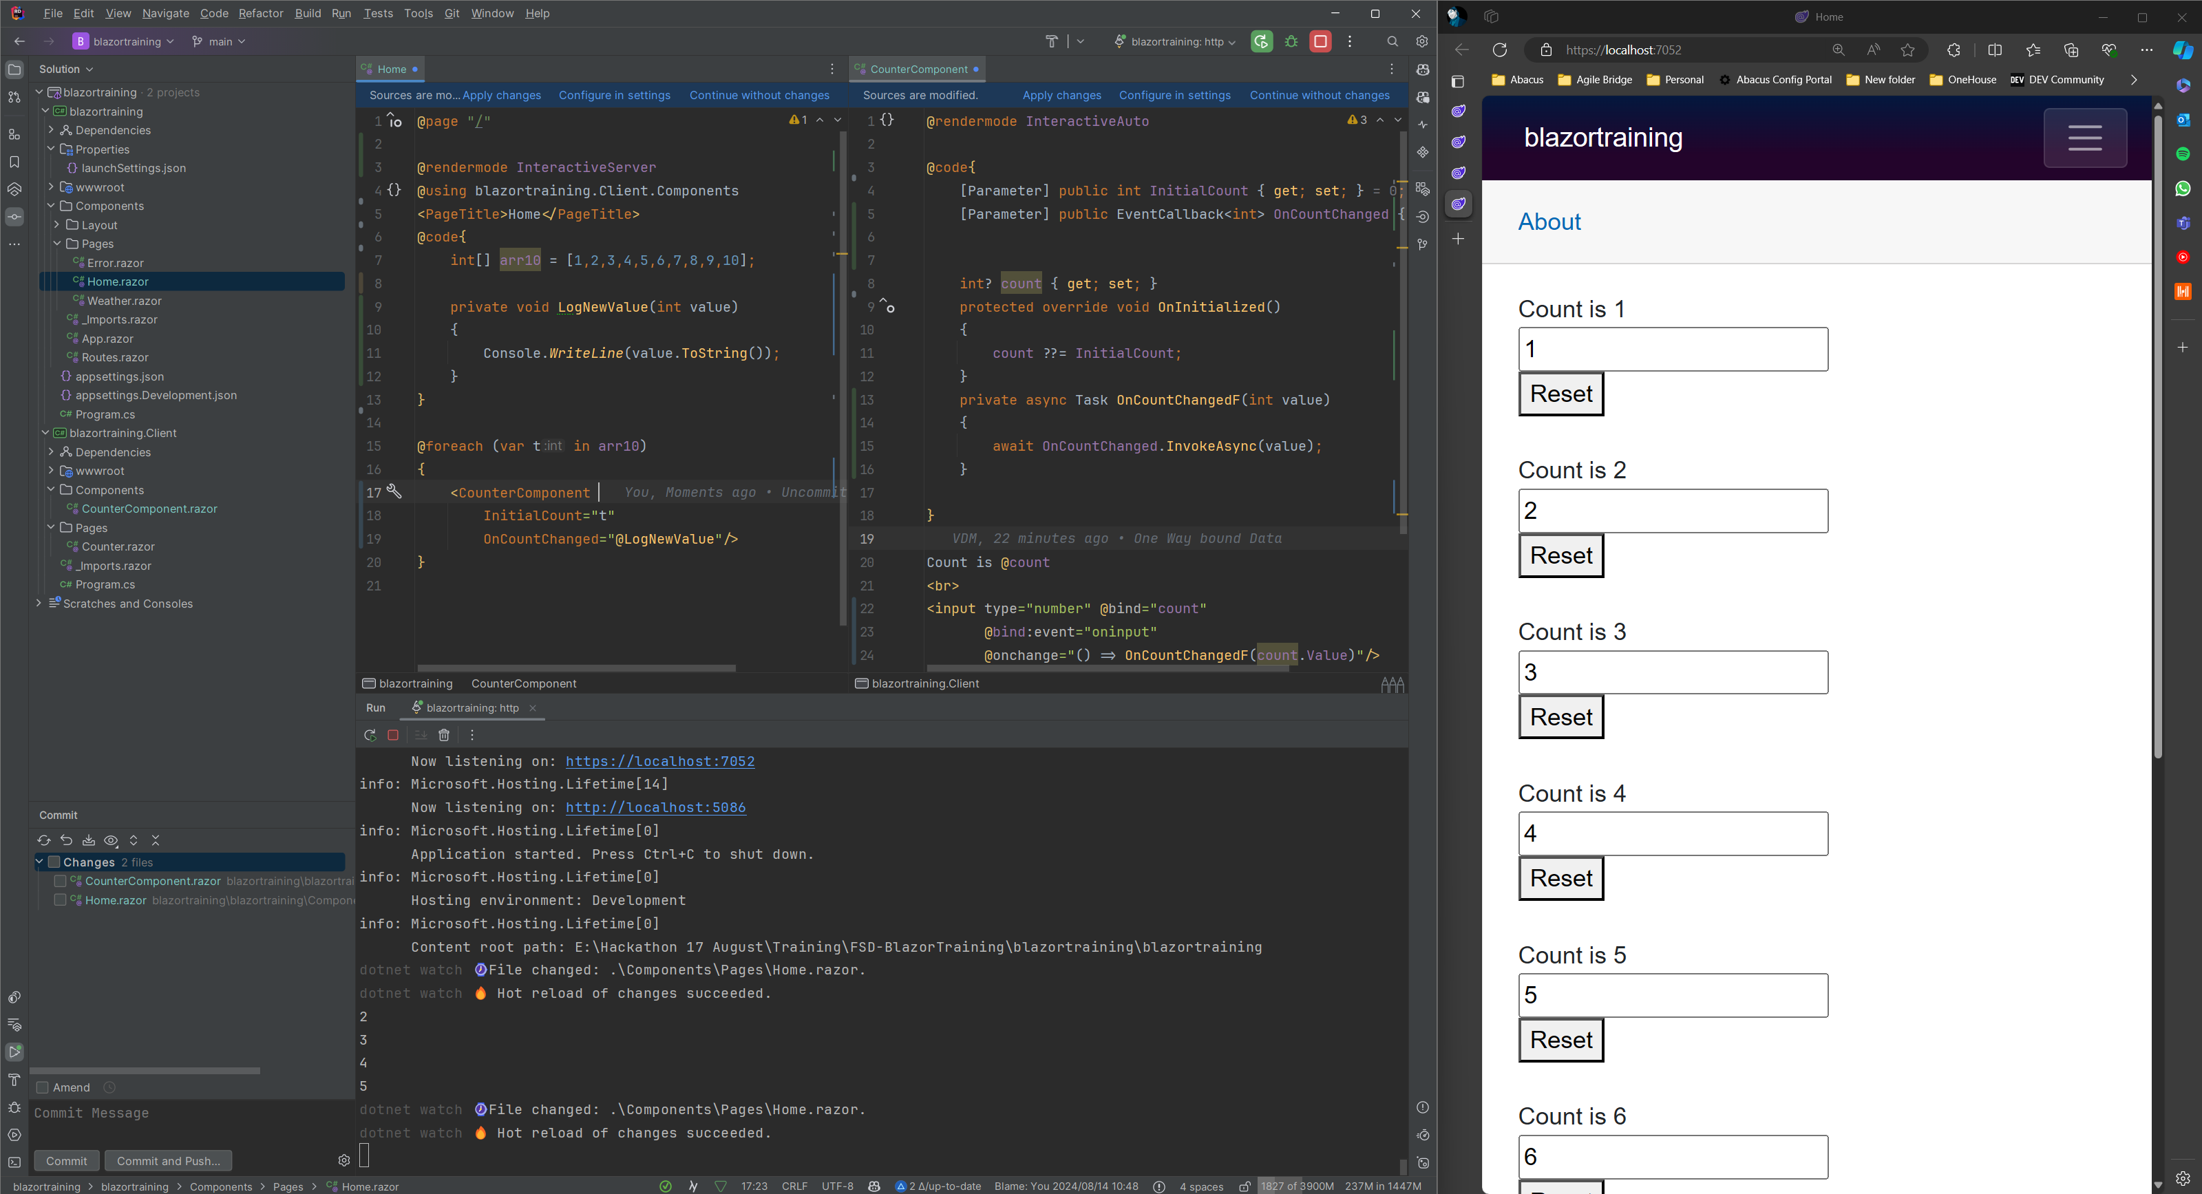
2d. Emitting Changes

Slide 13
Life Cycles

Slide 14
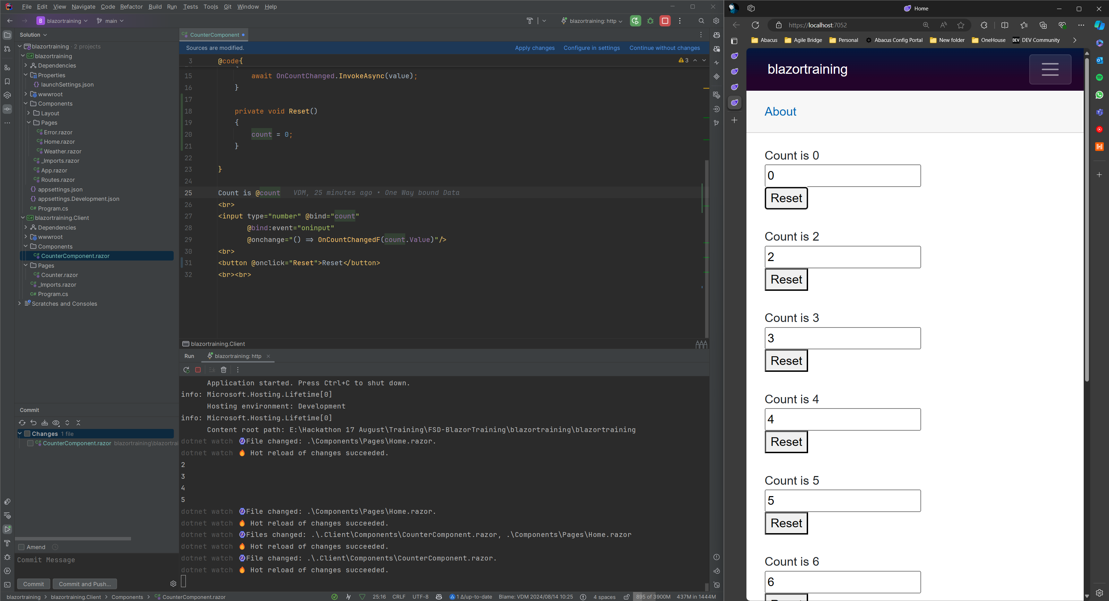
3a. Manually triggered Functions

Slide 15
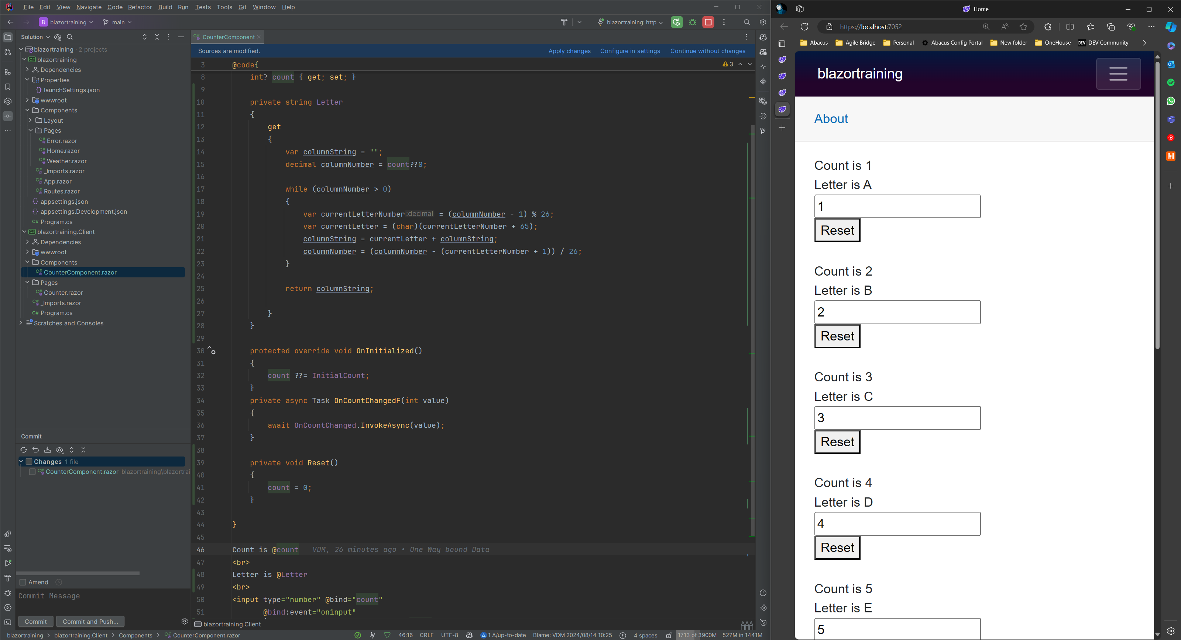
3b. Computed Functions

Slide 16
Routing

Slide 17
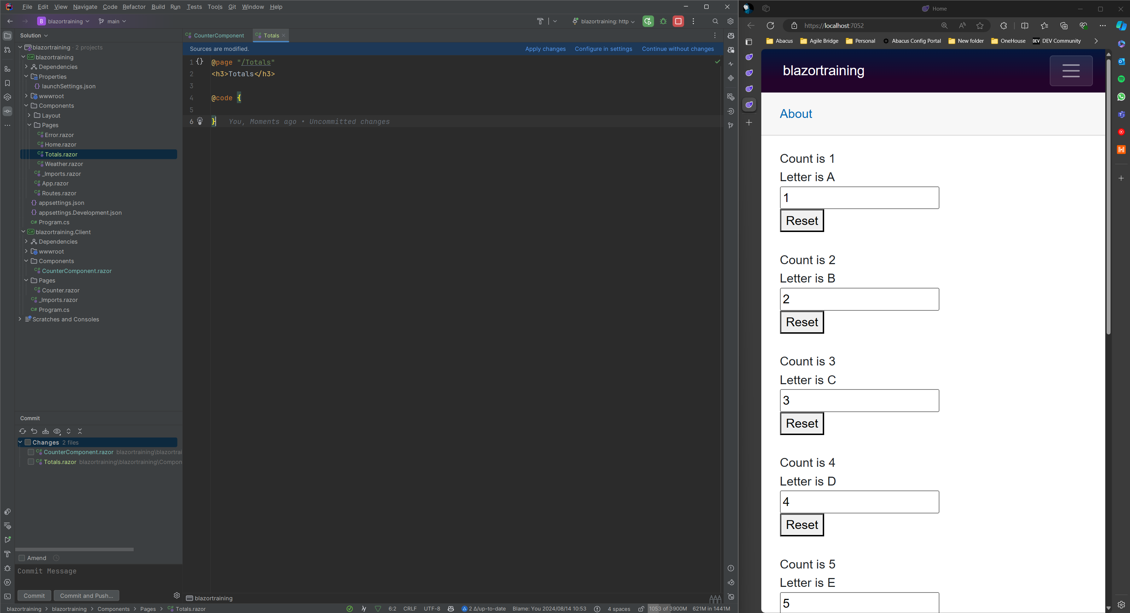
4a. Creating a new Page

Slide 18
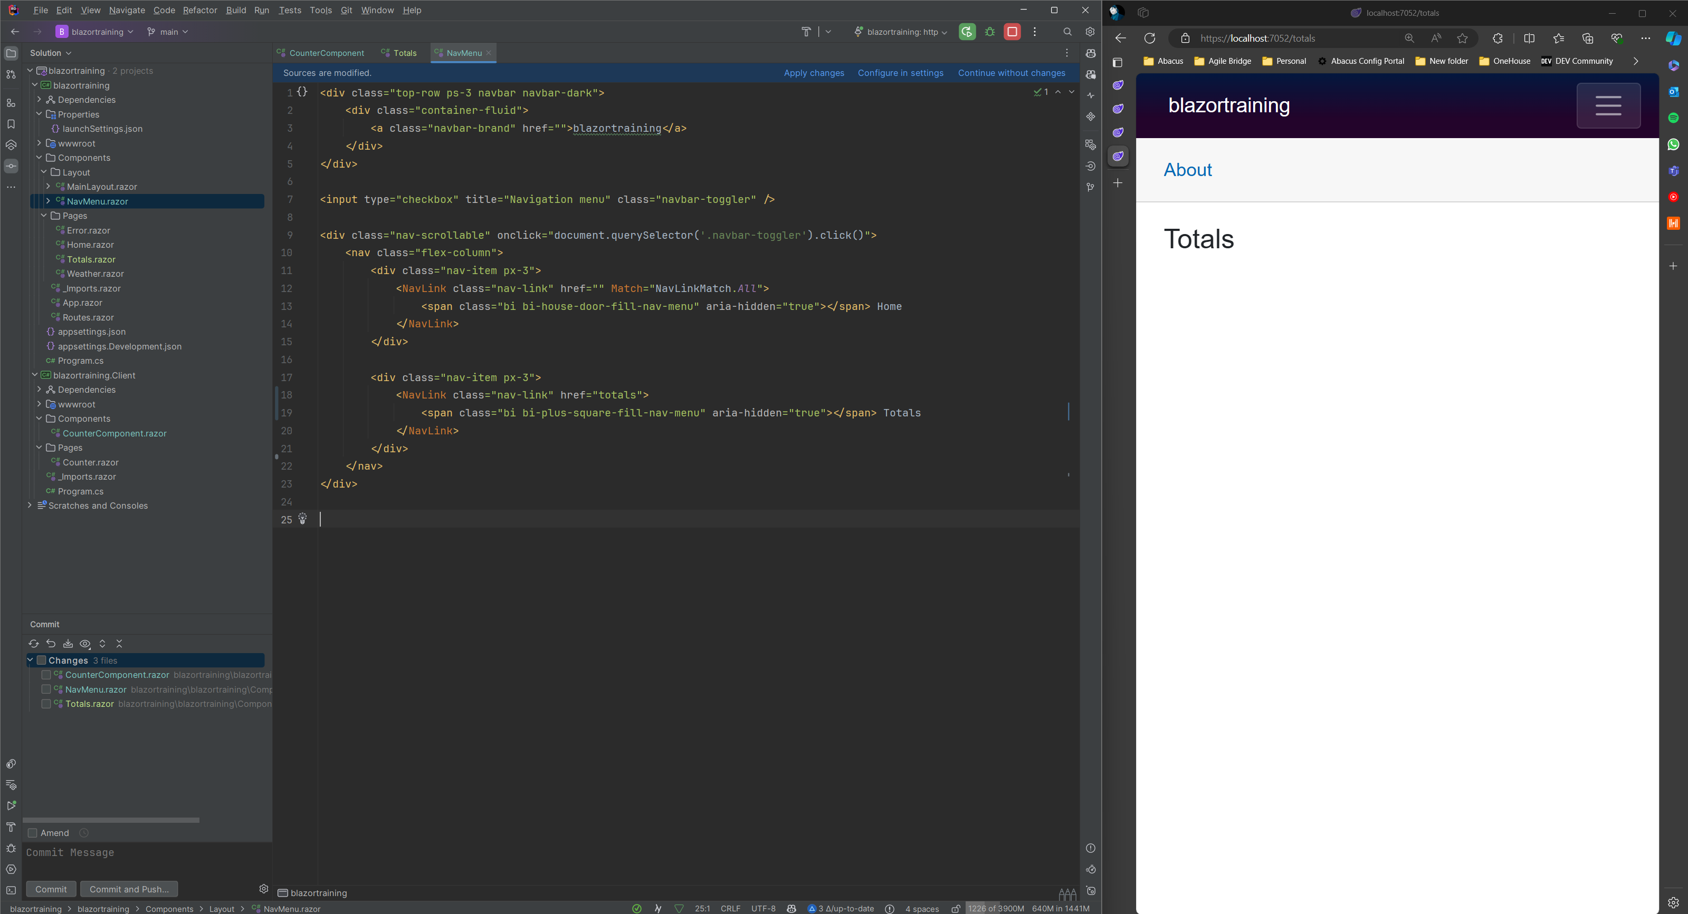
4c. Navigation Through Links

Slide 19
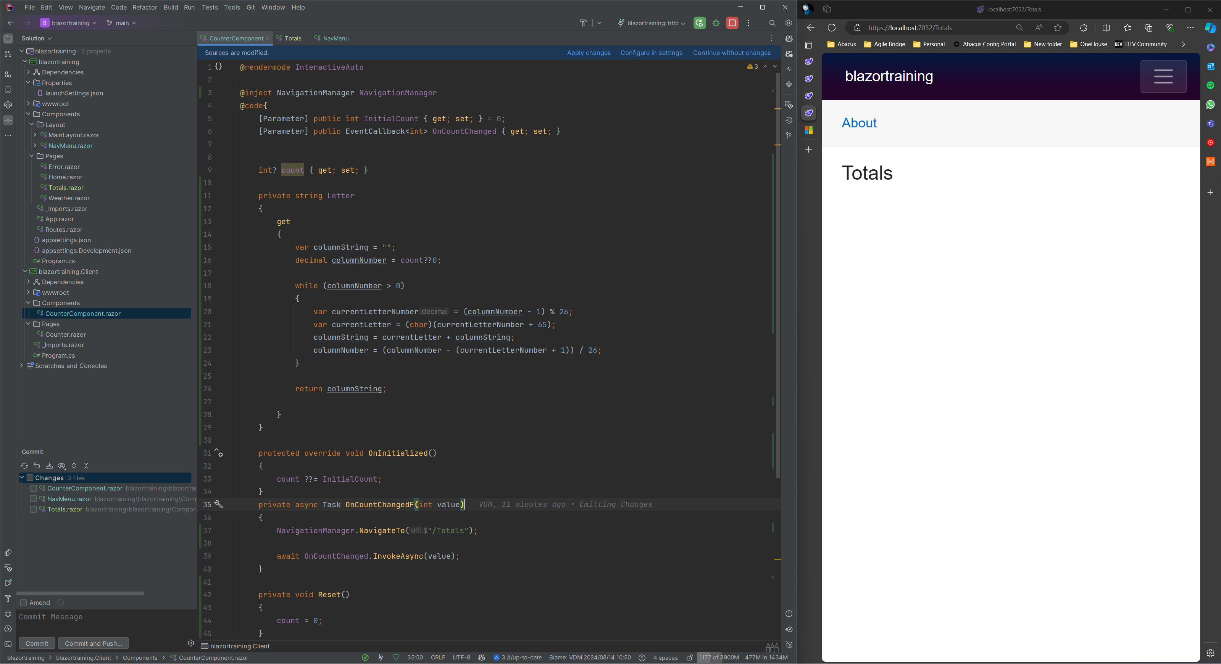
4f. Navigation Through Code

Slide 20
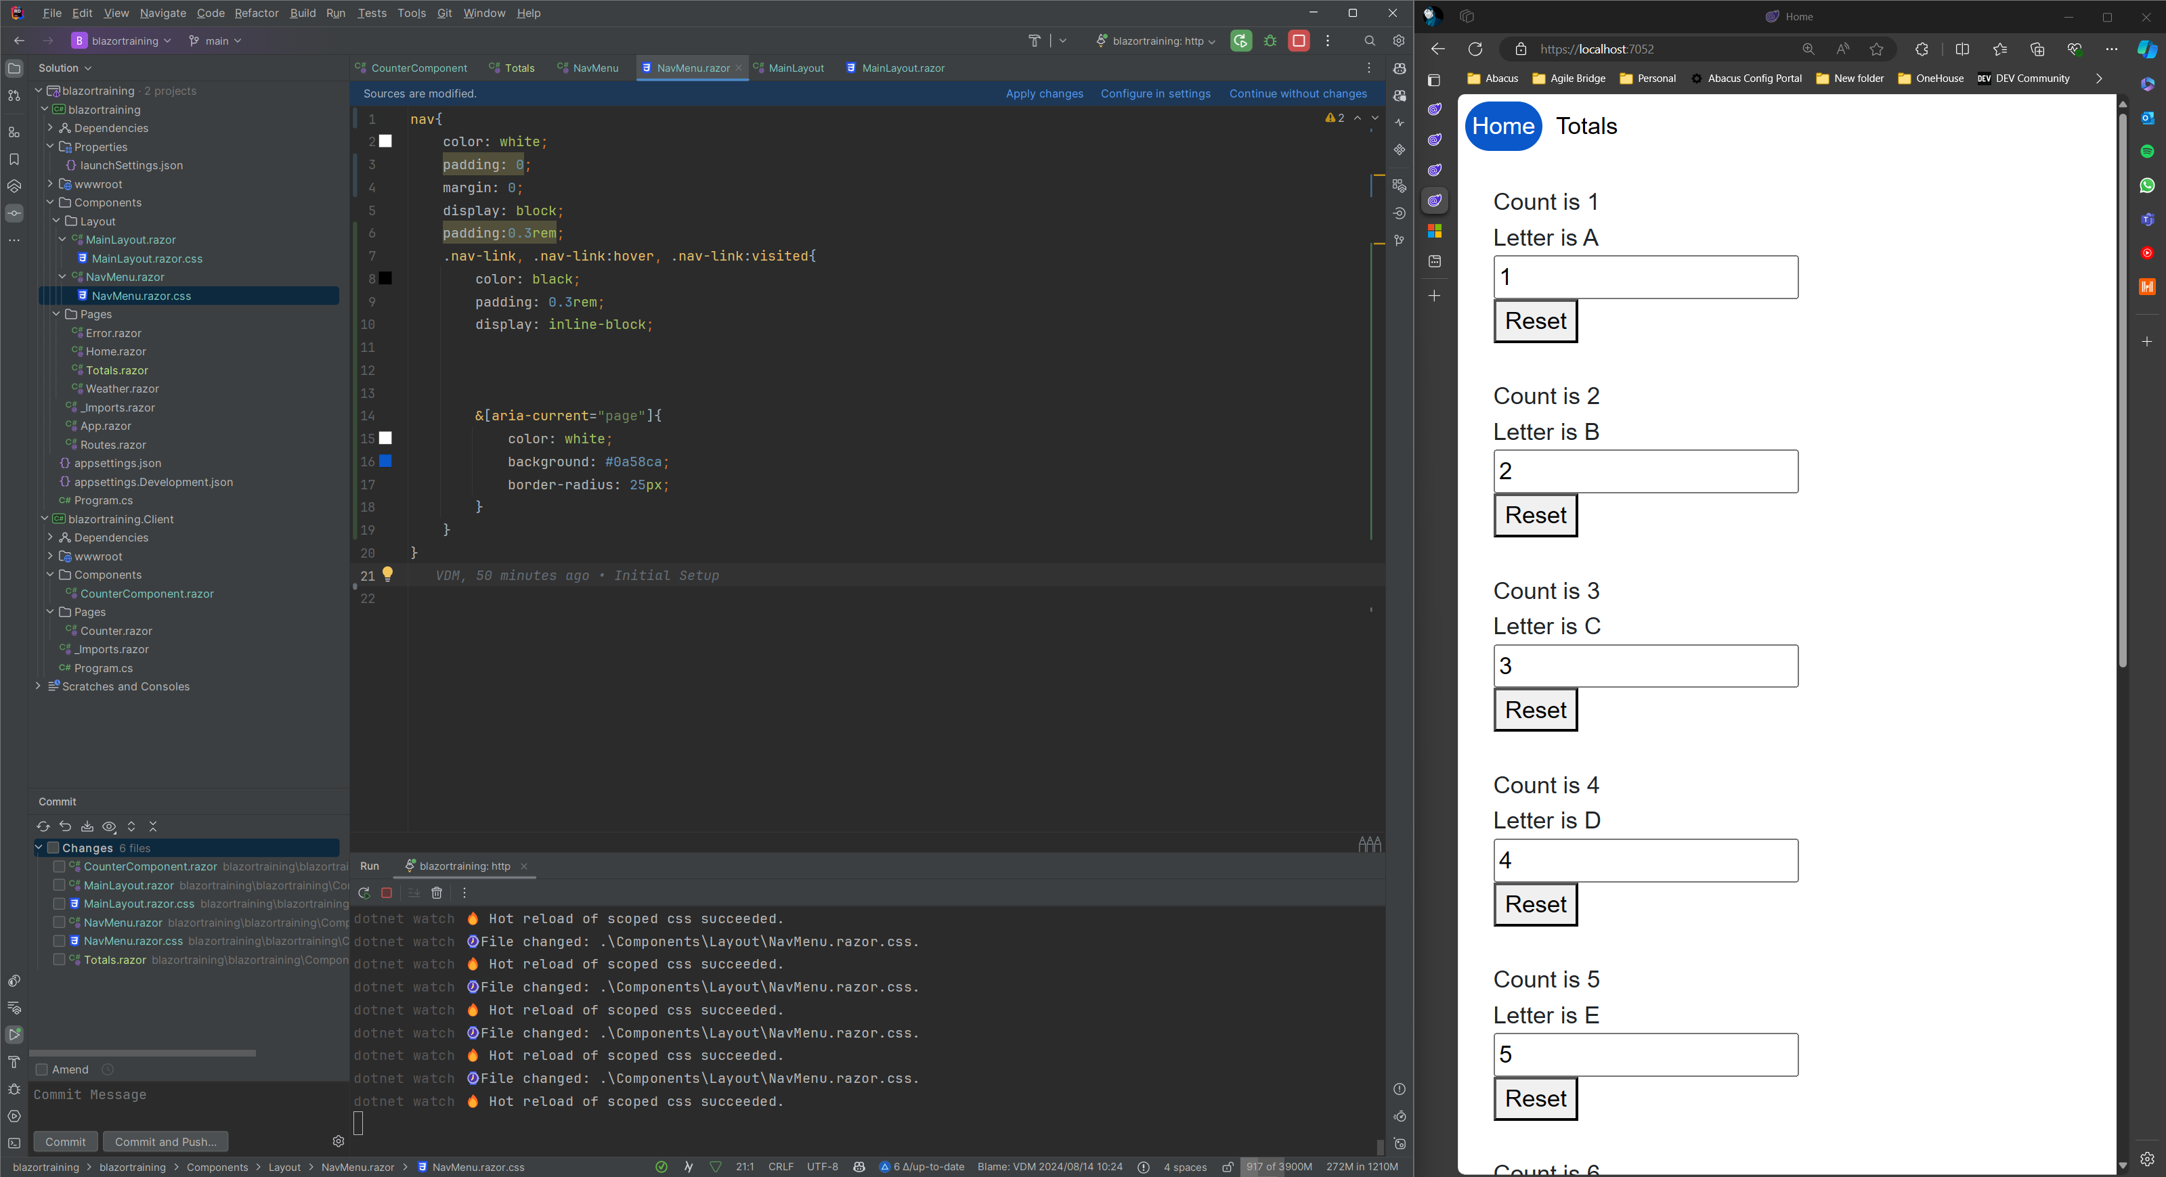
4g. Highlighting Active Page

Slide 21
Global Storage

Slide 22
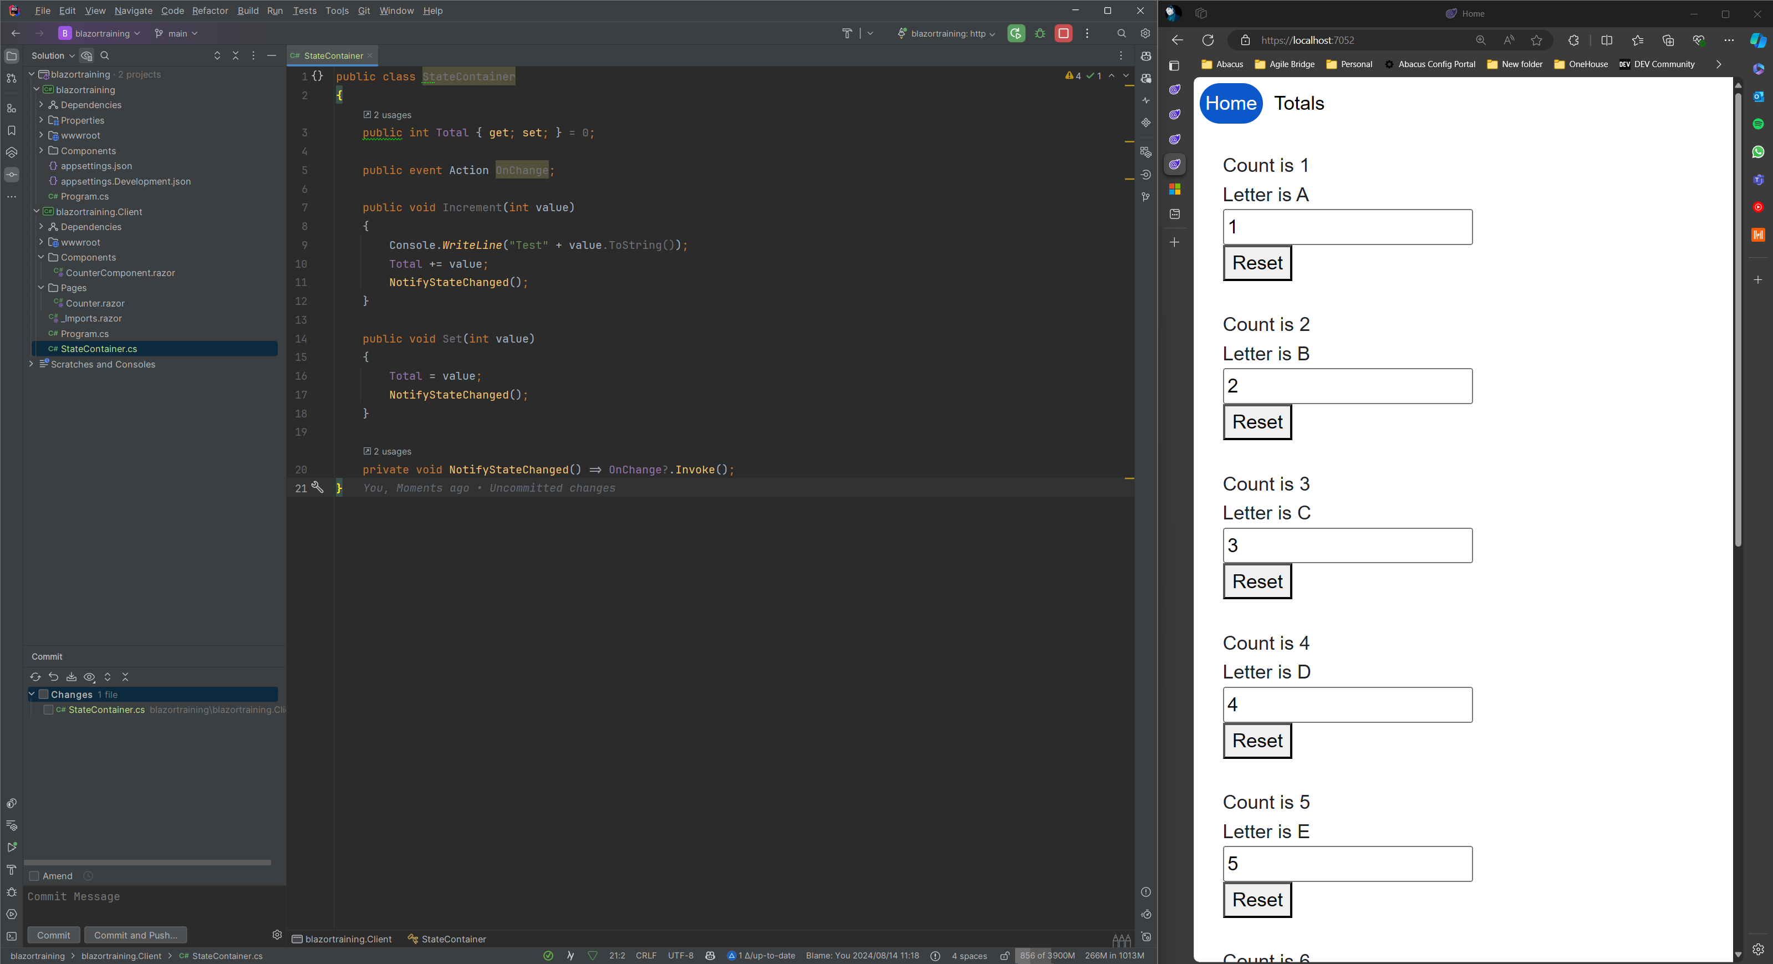
5c. Defining a store

Slide 23

5d. Updating The Store Values

Slide 24
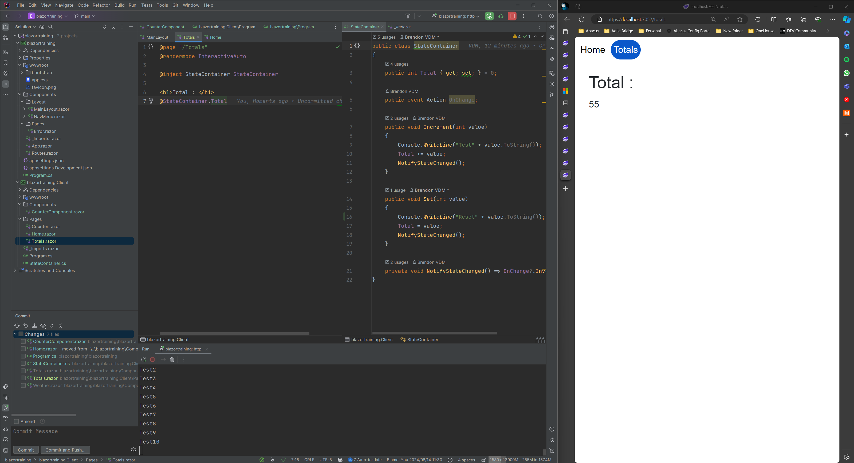
5e. Displaying store values

